Slide 1






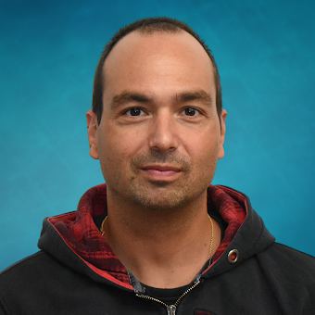




Enabling Scientific Discovery: Harnessing the Power of the National Science Data Fabric for Large-Scale Data Analysis (Session I & II)
Presenter: Michela Taufer¹
Other contributors: Heberth Martinez¹, Paula Olaya¹,Asshish Panta², Amy Gooch², Jack Marquez¹, Gabriel Laboy¹, Jay Ashworth¹, Giorgio Scorzelli² and Valerio Pascucci²
¹University of Tennessee Knoxville, ²University of Utah

Slide 2

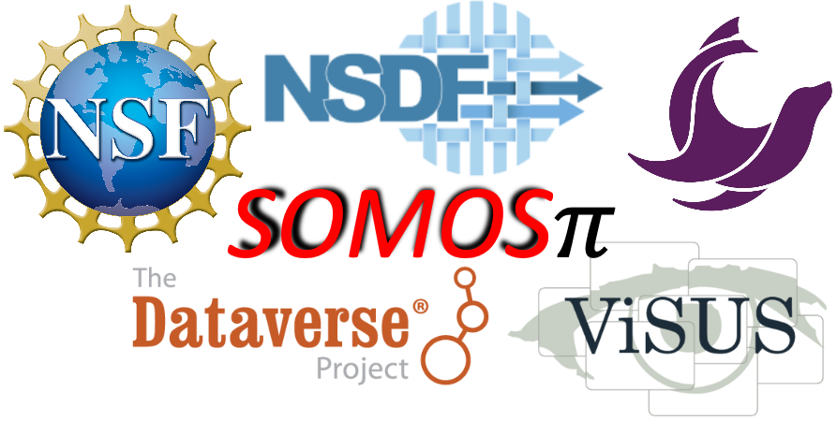
Acknowledgments
The authors of this tutorial would like to express their gratitude to:
NSF through awards 2138811, 2103845, 2334945, 2138296, and 2331152
Dataverse
Seal Storage
Rodrigo Vargas, Vargas Lab, University of Delaware
Werner Sun, CHESS, Cornell University
DOE SBIR Phase II award DE-SC0017152
Any opinions, findings, conclusions, or recommendations expressed in this material are those of the author(s) and do not necessarily reflect the views of the National Science Foundation.

Slide 3
Schedule
The half-day tutorial is organized into four sessions:
Session I (30 mins):
This session begins with an overview of the NSDF and addresses users' challenges identified through interviews.
Session II (1 hour):
This session offers a hands-on experience with NSDF services, focusing on visualization and dashboard creation for Earth science datasets.
Session III (1 hour):
This session delves deeper into NSDF services tailored for the management and analysis of datasets exceeding 100TB.
Session IV (30 mins):
This session concludes with an interactive Q&A, allowing attendees to discuss applications of NSDF in various research fields.

Slide 4


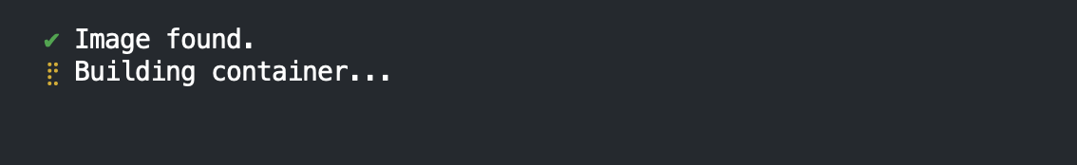
Prerequisites
Tutorial
Step 0: Access to GitHub
Step 1: Create Codespaces
To run this tutorial, you need to have a GitHub account.
You can create one following the instructions here:
https://docs.github.com/en/get-started/start-your-journey/creating-an-account-on-github#
Now you can login into GitHub
https://github.com/login
Use your GitHub account to run this tutorial with GitHub codespaces
Access this link: NSDF Tutorial 2024
Click on green button “Create codespace”
Notes:
Slides: https://docs.google.com/presentation/d/1iretit986m5EOL92UIf07UHQ-BGB5dkL/edit?usp=sharing&ouid=105842431565169409843&rtpof=true&sd=true Creation of Github Account: https://docs.github.com/en/get-started/start-your-journey/creating-an-account-on-github#
Github Login: https://github.com/login
Prerequisites: https://github.com/nsdf-fabric/NSDF_Tutorial/blob/main/README.md#prerequisites
README: https://github.com/nsdf-fabric/NSDF_Tutorial Creation of the github codespaces: https://codespaces.new/nsdf-fabric/NSDF_Tutorial

Slide 5
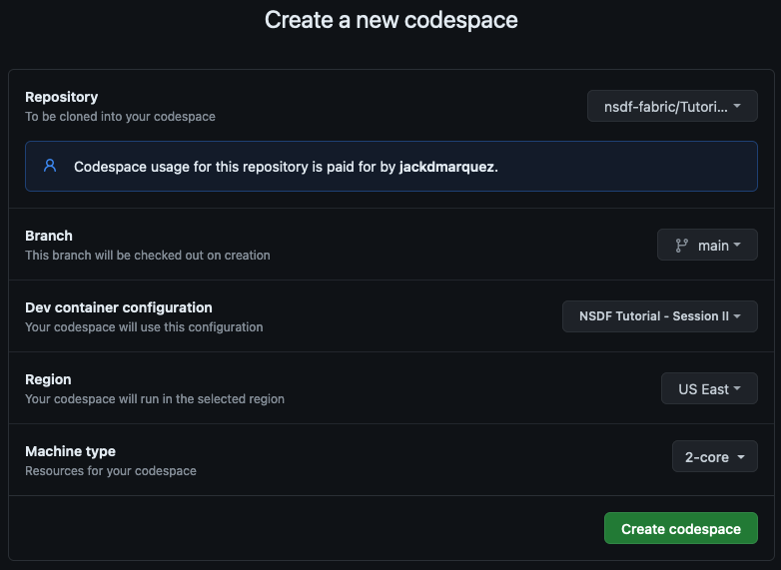
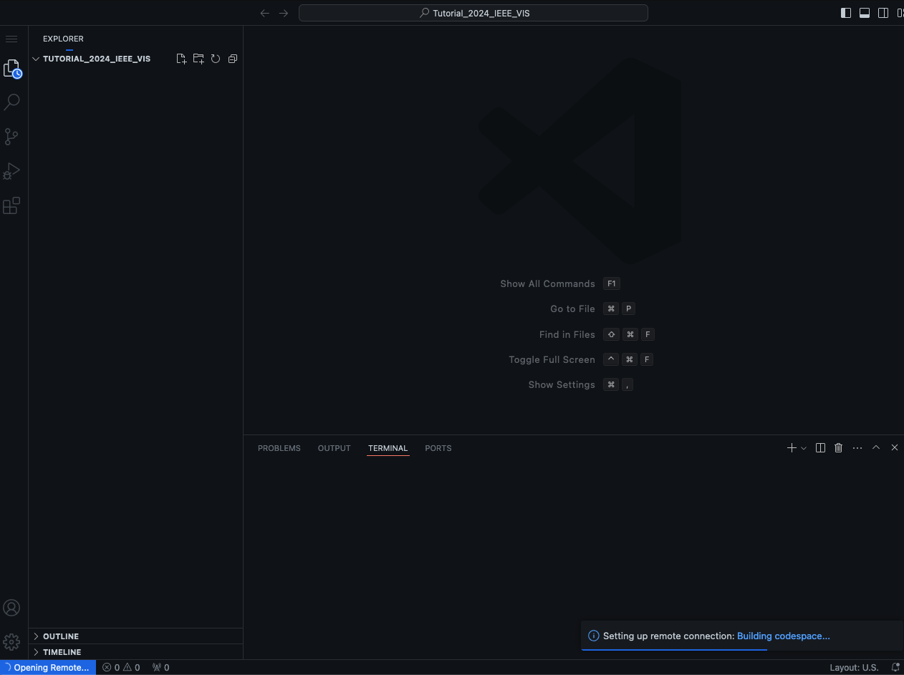
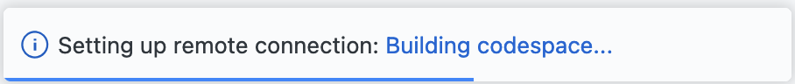
Creating the GitHub Codespace
Tutorial
You should see the GitHub codespaces set up.
Click this button ->
Let’s start: NSDF Tutorial 2024
Loading GitHub Codespace can take from 1 to 5 minutes

Slide 6

Tutorial Goals
This tutorial demonstrates end-to-end analysis of scientific data through NSDF services
Tutorial
Goals
Construct a modular workflow that combines your application components with NSDF services
Upload, download, and stream data to and from public and private storage solutions
Deploy the NSDF dashboards for large-scale data access, visualization, and analysis

Slide 7
Session I: Understanding and Addressing User’s Pain Points
Surveying Community Needs and Realities

Slide 8
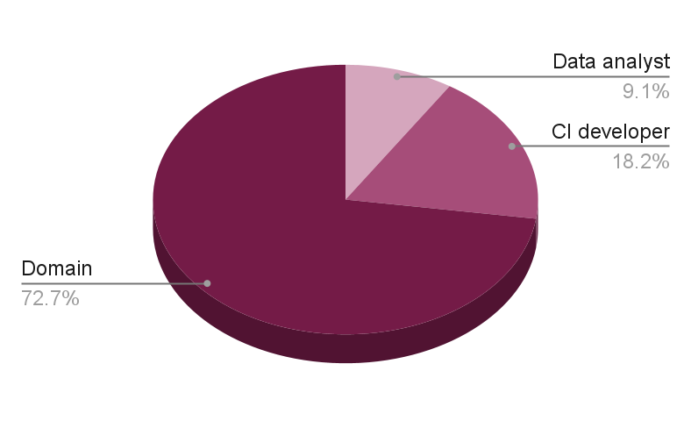
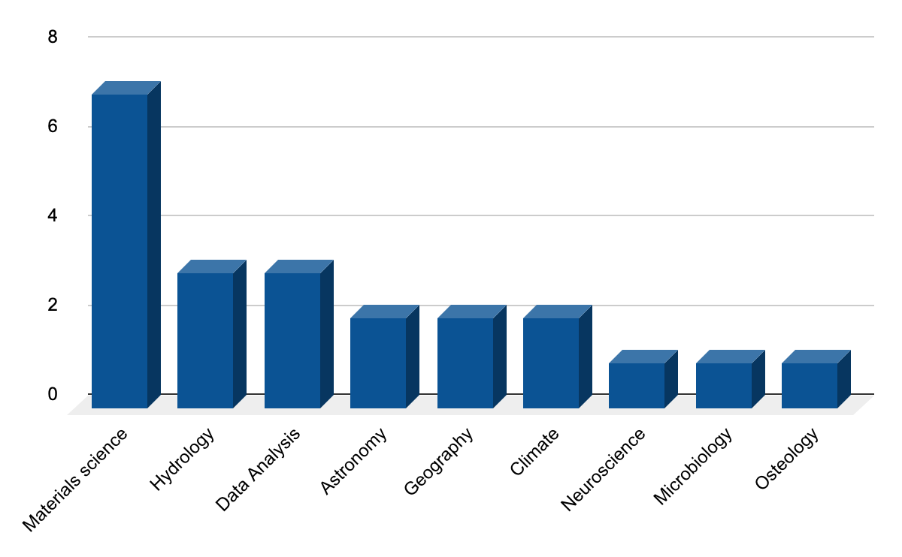
Identifying Pain Points: User Interviews
Identify Users
Target Questions
Analyze Results
Diagnose Pain Points
Diverse roles: Domain scientists, CI professionals, developers
Diverse domains: materials science, climate, earth sciences, astronomy, and more!
Diverse institutions: R1 universities, teaching colleges, MSIs, national labs, experimental facilities
General questions about data storage, data form, metadata storage, WMS, data catalogs, programming languages
Specific questions about unique challenges related to role, domain, and institution
Identify cross-cutting concerns
Identify concerns consistent for roles, domains, and institutions
Distill concerns into concrete problem statements
Translate into objectives, actionable items, and milestones
Domain Experts

Slide 9
Identifying Pain Points: Testimonials
“We don’t have a plan to scale storage if our cyberinfrastructure takes off.” - Cyberinfrastructure developer, Hydrology
“We can’t scale to PB data without massive funding or infrastructure. We need centralized point of access to federated data” - Cyberinfrastructure Developer, Materials Science
“If we make it easy, people will share their data. We need to extend the scalability of our infrastructure through community supplied storage.” - Project PI, Materials Science
“We lack personnel to do basic development and maintenance of our systems” - Cyberinfrastructure Developer, Astronomy
“The time and effort for using public repositories, and limited realized gains limits our data sharing” - Faculty, Materials Science
Cyber- infrastructure Developer
Senior Faculty, Multi-institution Project PI
NSDF
User Communities
“We can’t hire enough system maintainers and have research funding” - Data Analyst Group Lead
Technical Support Staff
“Remote quality control during acquisition would let us better use beamline time” - Faculty, Materials Science
Research Faculty, Smaller Projects
Research Staff
“Jupyter notebook access to data (TBs) would reduce barrier to entry ” - Research Staff, Climate Science
“Before I had funding to run my own experiments, data shared by a friend at a national lab launched my research career” - Faculty, Materials Science
Junior Faculty
Postdoc/Grad Students
“A student copies GBs of data from the scientist to my institution. I download to my laptop to prototype analysis. It is cumbersome and limits testing.” - Research Staff, Data Analysis
“I’m perplexed by the lack of urgency around reproducible and replicable processes for data management” - Faculty, Geography
“Our old data is kept on (external) drives. It's hard to keep things organized” - Graduate Student, Materials Science
“Our long-term storage is a shelf of external hard drives” - Research Staff, Neuroscience
“We move data (from light source) by flying back with TB hard drives” - Graduate Student, Materials science
Notes:
We found that the pain points, and potential gains of technology, were different for different roles. for instance a common pain point for cyber instructor developers was a lack of personnel and inability to hire the needed people to sustain or grow cyber infrastructure. Research staff, post stocks and graduate students were involved with the majority of the day-to-day data movement and data management in scientific investigations and they reported pains ranging from cumbersome or slow data movement practices such as physically flying hard drives between image sources and home institutions, to organizational practices that in some extreme cases involve the project pi remembering which hard drives had which experiments. For junior faculty, a common theme was that access to others high quality data often launch their entire career, and led to their own funding to acquire data.

Slide 10


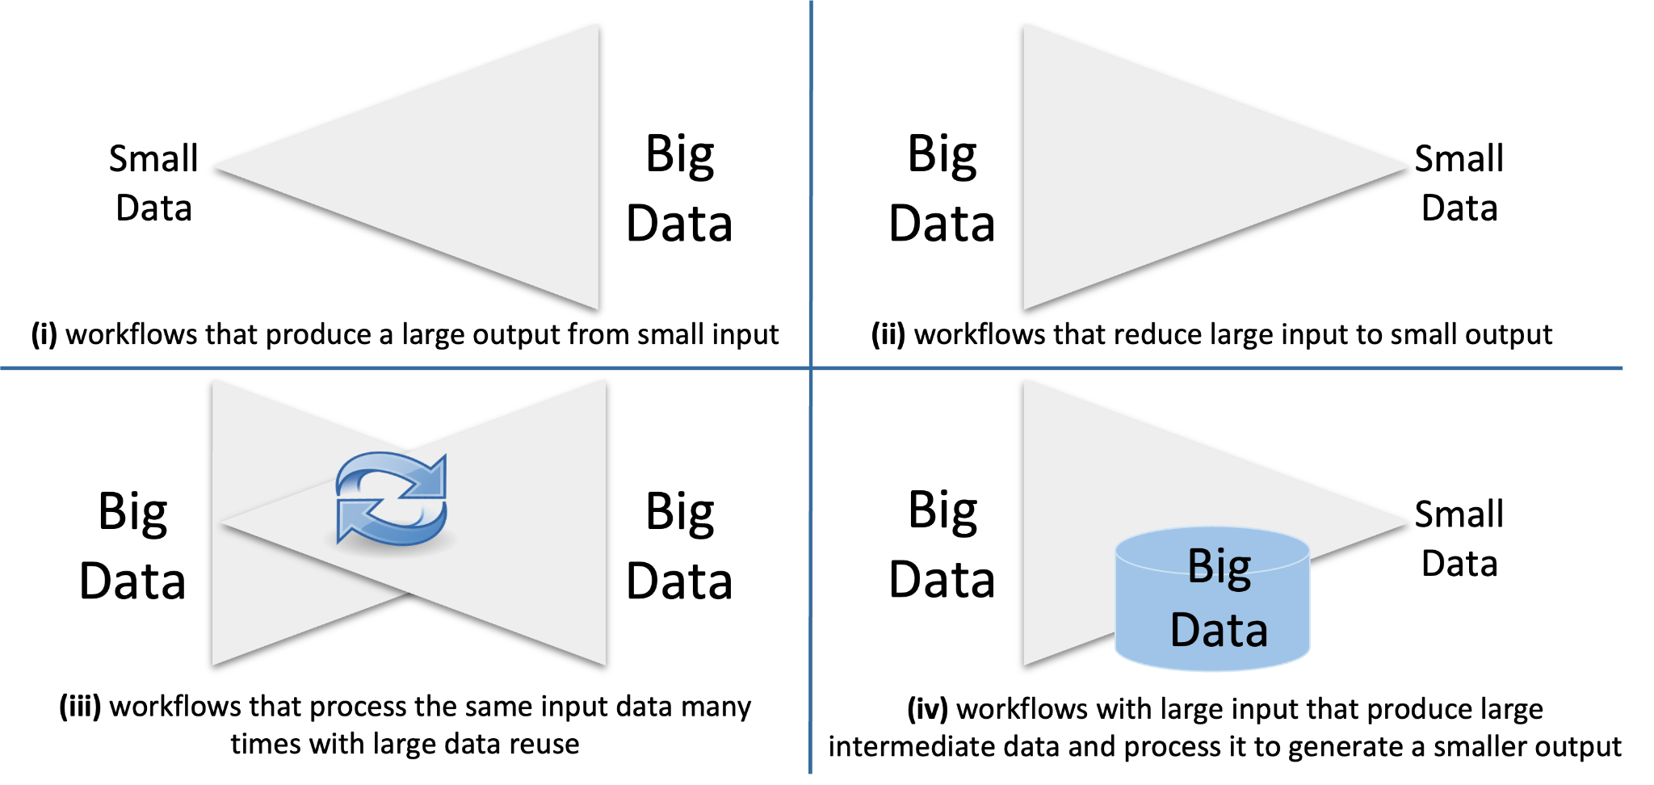






Pain Points Inform Data Science Strategies
Scalability Software stack scale from leadership computing to commodity hardware (even handheld)
Information Streams federated resources that minimize data transfers with trustworthy sharing of information
Resource Efficiency Allows teams to work effectively with limited access to human and physical resources
Data Management Standardized data and metadata management tools avoid replicated work
Accessibility Facilitate data-sharing processes for open and secure environments
Timeliness Immediate access and use of remote information without bulk data transfers
Workforce Development Trained of CI professionals
Replicability Programs/data versioning with FAIR identifiers throughout the scientific investigation
NSDF focuses on the main classes of workflows that CHALLENGE data-intensive scientific investigations
‹#›

Slide 11

What do Scientists Need?
Findable, Accessible, Interoperable, Reusable
(FAIR) data
Information streaming: knowledge exploration
at run time
Equity in
access and use
Access and use of data from remote facilities (experimental, computing, and repository)
Remote queries with minimal data movement to mitigate bandwidth and storage issues
‹#›

Slide 12
Session I: Implementing an Accessible & Tightly Integrate Data Fabric
Designing, developing, and deploying equitable services

Slide 13


We are building a holistic ecosystem to democratize data-driven scientific discovery by connecting an open network of institutions, including minority-serving institutions, with a shared, modular, containerized data delivery environment.
http://nationalsciencedatafabric.org/

Slide 14
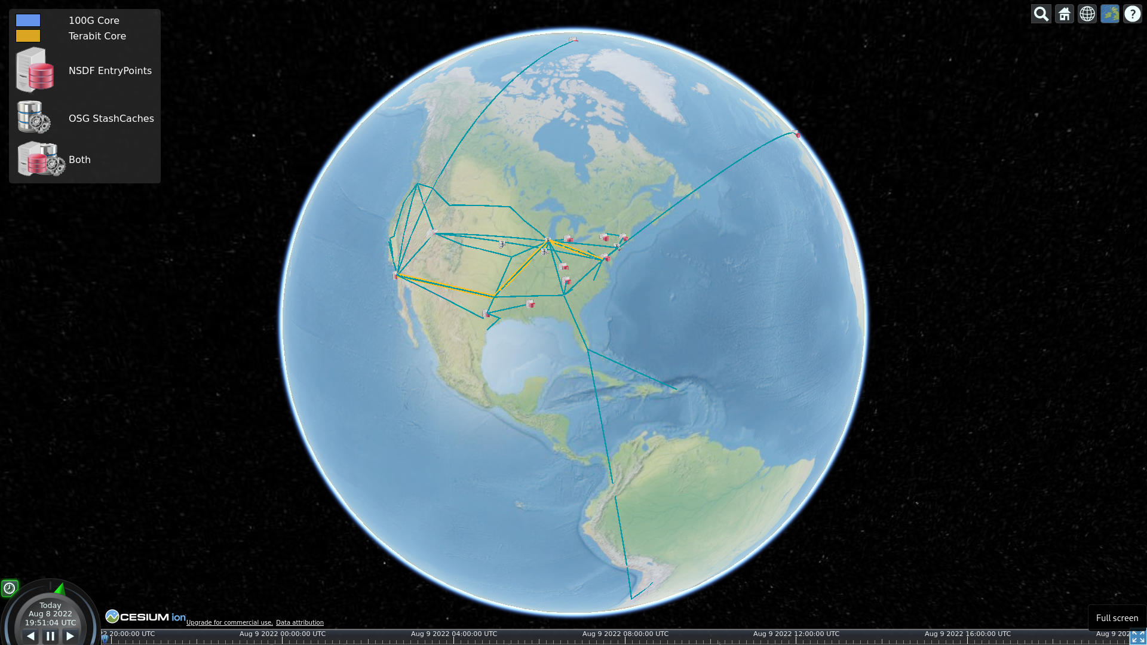
UMICH
UTAH
JHU
SDSC
UTK
Institutions and universities with resources to share
Notes:
The NSDF pilot supports the IceCube neutrino observatory and the XenonNT dark matter detector advances the understanding of the evolution of galaxies and the nature of “dark matter” and “dark energy.

Slide 15
UMICH
UTAH
JHU
SDSC
UTK
UTEP
UC Denver
Initiative to integrate minority serving institutions
UTSA
Dillan U.
Notes:
Now where does democratization come into the picture
https://www.minorityhealth.hhs.gov/assets/PDF/2020_Minority_Serving_Institutions.pdf
https://orise.orau.gov/msipp/documents/approved-msi-school-list.pdf

Slide 16
PRISMS Materials Commons UMICH
UTAH/SCI
CHESS/Cornell
MGHPCC + OSN
JHU
SDSC + OSG
UTK
Initiative to integrate large scale scientific projects
Digital Rocks
Notes:
The NSDF pilot supports the IceCube neutrino observatory and the XenonNT dark matter detector advances the understanding of the evolution of galaxies and the nature of “dark matter” and “dark energy.

Slide 17
PRISMS Materials Commons UMICH
LLNL
UTAH/SCI
CHESS/Cornell
CHPC
MGHPCC + OSN
JHU
SDSC + OSG
SNL
UTK
Initiative to integrate HPC resources
Digital Rocks
MS-CC
TACC
Notes:
Integrating HPC

Slide 18
PRISMS Materials Commons UMICH
LLNL
UTAH/SCI
CHESS/Cornell
CHPC
MGHPCC + OSN
JHU
Internet2
SDSC + OSG
SNL
UTK
Initiative to integrate public cloud resources
MS-CC
TACC
XSEDE/ACCESS
Jetstream2
CloudLab
Chameleon
CyVerse
Notes:
Ping Giorgio to acknowledge all the institutions providing
CI Consortium

Slide 19
PRISMS Materials Commons UMICH
LLNL
UTAH/SCI
CHESS/Cornell
CHPC
MGHPCC + OSN
JHU
Internet2
SDSC + OSG
SNL
UTK
Initiative to integrate enterprise
cloud and storage resources
MS-CC
TACC
XSEDE/ACCESS
Jetstream2
CloudLab
Chameleon
IBM Cloud
CyVerse
CloudBank (AWS, Azure)
Storage Providers (Seal, MinIO)
Notes:
scientists must navigate a fragmented landscape of computing providers, conflicting best practices, and technical jargon [ 4–7 ] across multiple centers with various resources

Slide 20

IceCube
XenonNT
A data fabric must be accessible and tightly integrated
to coordinate data movement and use
among geographically distributed teams or organizations
PRISMS Materials Commons UMICH
LLNL
UTAH/SCI
CHESS/Cornell
CHPC
MGHPCC + OSN
JHU
Internet2
SDSC + OSG
SNL
UTK
MS-CC
TACC
XSEDE/ACCESS
Jetstream2
CloudLab
Chameleon
CyVerse
IBM Cloud
CloudBank (AWS, Azure, …)
Notes:
Several national reports have stressed the urgency of connecting data sources, computing environments, and scientific investigators by addressing the critical challenge of democratizing data delivery [9–11].

Slide 21
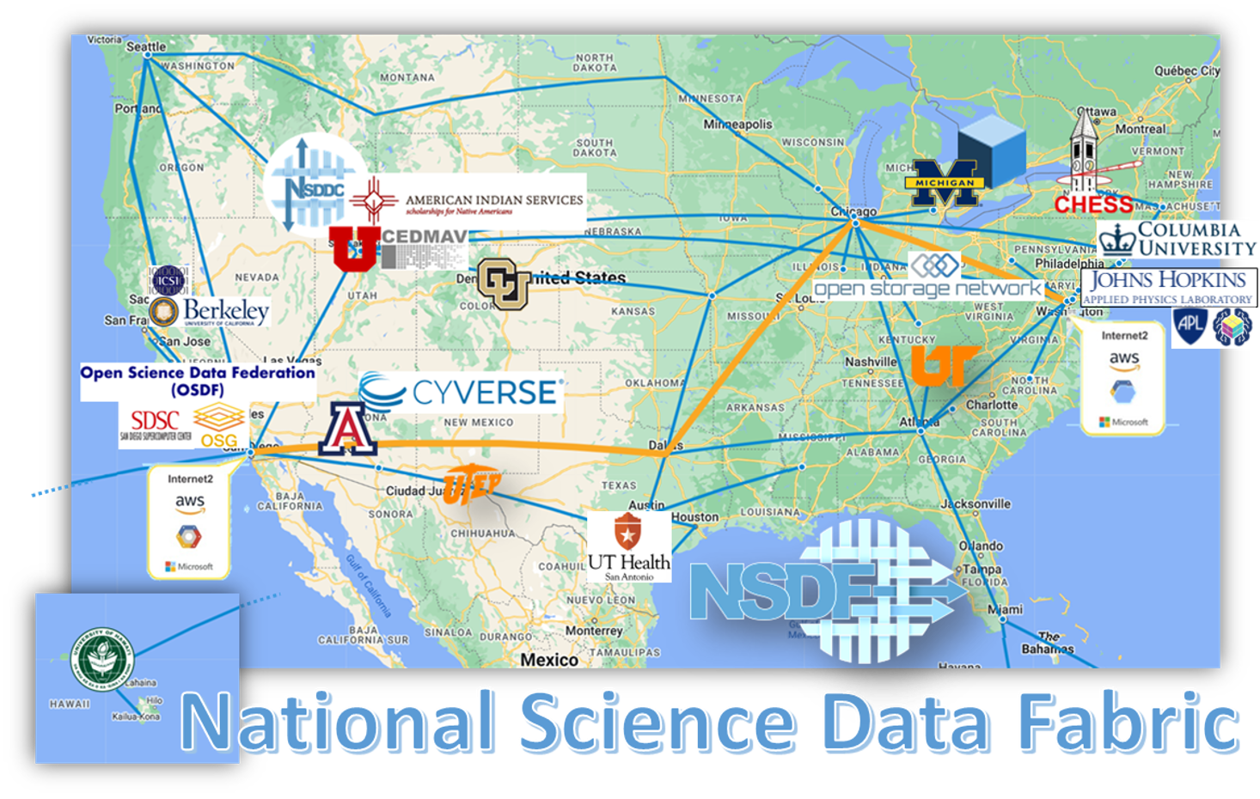

Slide 22



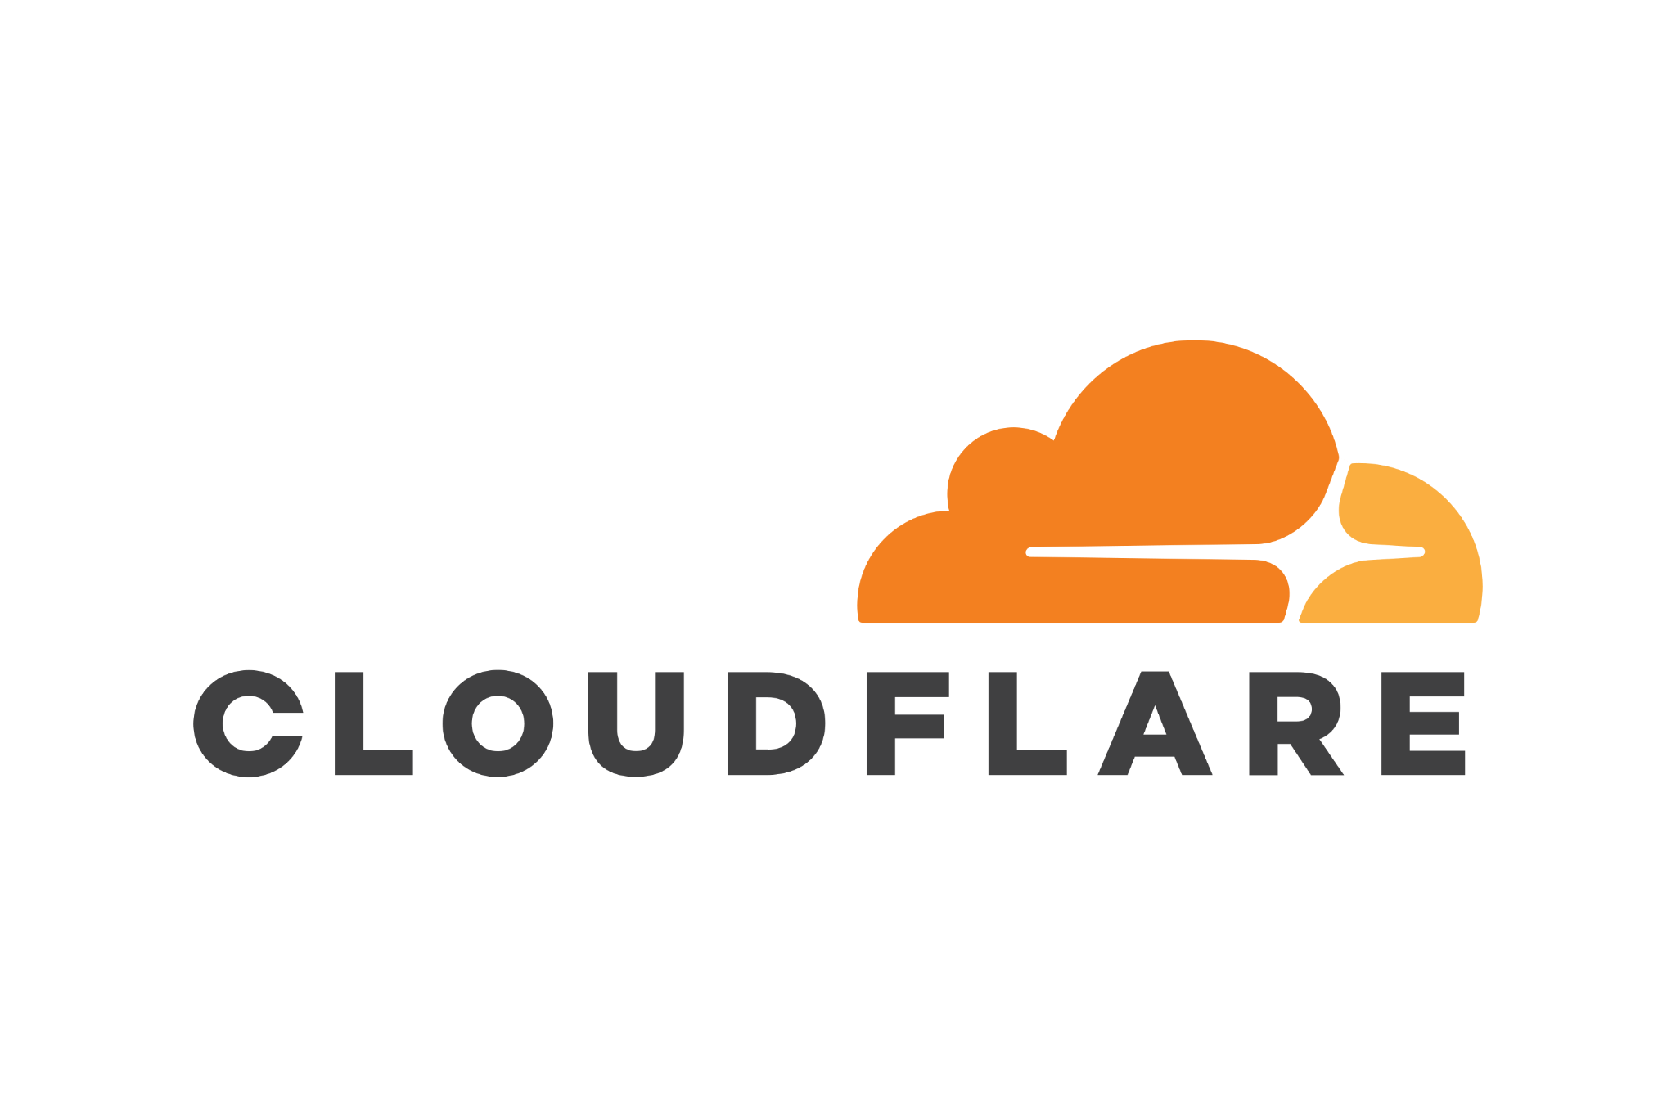






National Science Data Democratization Consortium: Engaging Industry Partners

Slide 23



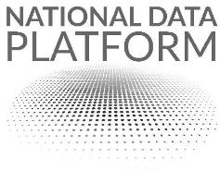





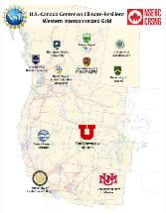



Partnering with Existing NSF Initiatives

Slide 24




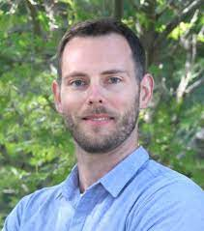


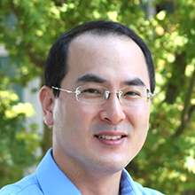
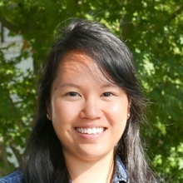

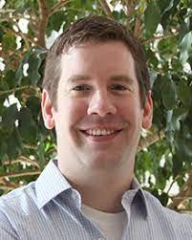
Partnerships with DoE Labs
Sandia National Laboratories
Workflow containerization (Trustworthy Computing; Data Democratization)
Lawrence Livermore National Laboratory
Thicket project (Large Scale Computing and Performance)
Flux project (Scheduling and Resource Management)
Fractale (Convergence of HPC, Cloud, and Edge)

Slide 25
Session I: Our Services and Successful Stories
Democratizing Access and Use of Large-scale Data

Slide 26
IceCube
XenonNT
A data fabric must be accessible and tightly integrated
to coordinate data movement and use
among geographically distributed teams or organizations
Develop a FAIR, AI-ready, transdisciplinary software stack that is easy to use, integrate, and scale
Develop a federated data fabric: a suite of equitable network, computing, and storage services interoperating across the academic and commercial cloud
PRISMS Materials Commons UMICH
LLNL
UTAH/SCI
CHESS/Cornell
CHPC
MGHPCC + OSN
JHU
Internet2
SDSC + OSG
SNL
UTK
MS-CC
TACC
XSEDE/ACCESS
Jetstream2
CloudLab
Chameleon
CyVerse
IBM Cloud
CloudBank (AWS, Azure, …)
Notes:
Several national reports have stressed the urgency of connecting data sources, computing environments, and scientific investigators by addressing the critical challenge of democratizing data delivery [9–11].

Slide 27
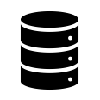


NSDF Services
Networking & Transfer
Computing & Monitoring
NSDF
NSDF-Fuse
NSDF-Catalog
NSDF-Stream
NSDF-Dashboards
NSDF-OpenVisus
NSDF-Notebooks
NSDF PLATFORM
NSDF-Plugin
NSDF-Data Transfer
NSDF-Cloud
NSDF-Monitoring
NSDF-Workflow
Data & Storage

Slide 28
NSDF Services
Networking & Transfer
Computing & Monitoring
NSDF
NSDF-Fuse
NSDF-Catalog
NSDF-Stream
NSDF-Dashboards
NSDF-OpenVisus
NSDF-Notebooks
NSDF PLATFORM
NSDF-Plugin
NSDF-Data Transfer
NSDF-Cloud
NSDF-Monitoring
NSDF-Workflow
Data & Storage

Slide 29
Section I: Sharing Use-Inspired Research Stories
Decentralizing Research Hubs for Transformative Scientific Discovery

Slide 30
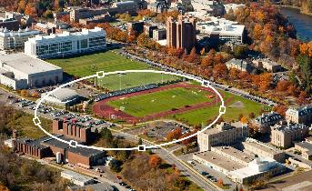
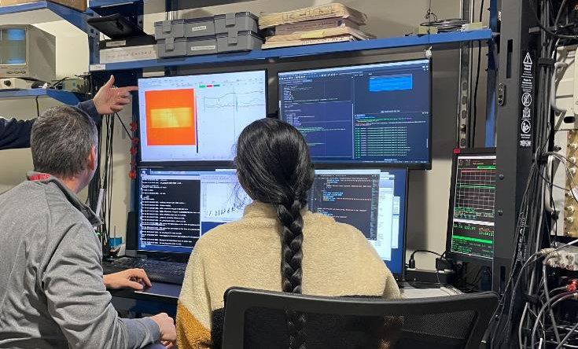
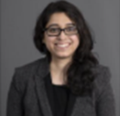

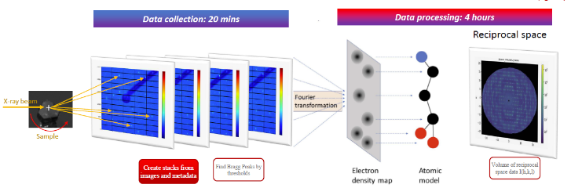
Equity in the Use of Experimental Facilities
Establishing a comprehensive workflow from experimental facilities to the end-user data analysis.
Cornell High Energy Synchrotron Source: Quantum Materials Beamline (6 of the 8 lines)
Real-time data access and sharing
Steering experiments
AI-driven workflows
Remote team collaboration
Optimize effective use of scientists’ time and national resource
Publish data with no delay (e.g., Materials Commons) 🡪 in real-time
Suchismita Sarker
Staff Scientist
Kate Shanks
Staff Scientist
200TB data, 10M files in 2 beamlines over 2 months

Slide 31

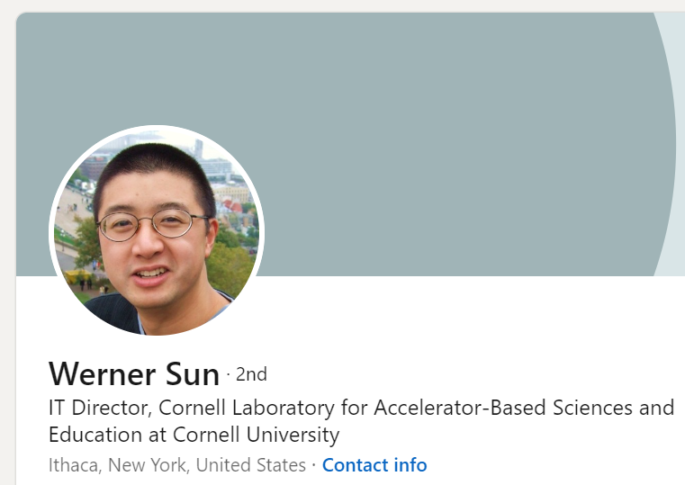
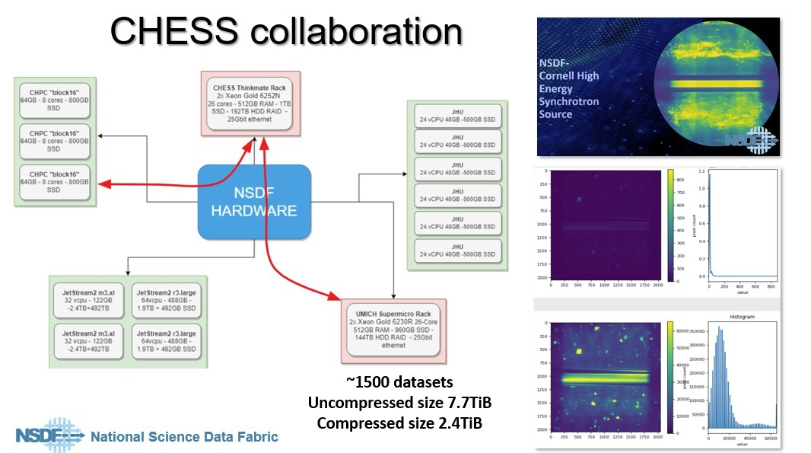
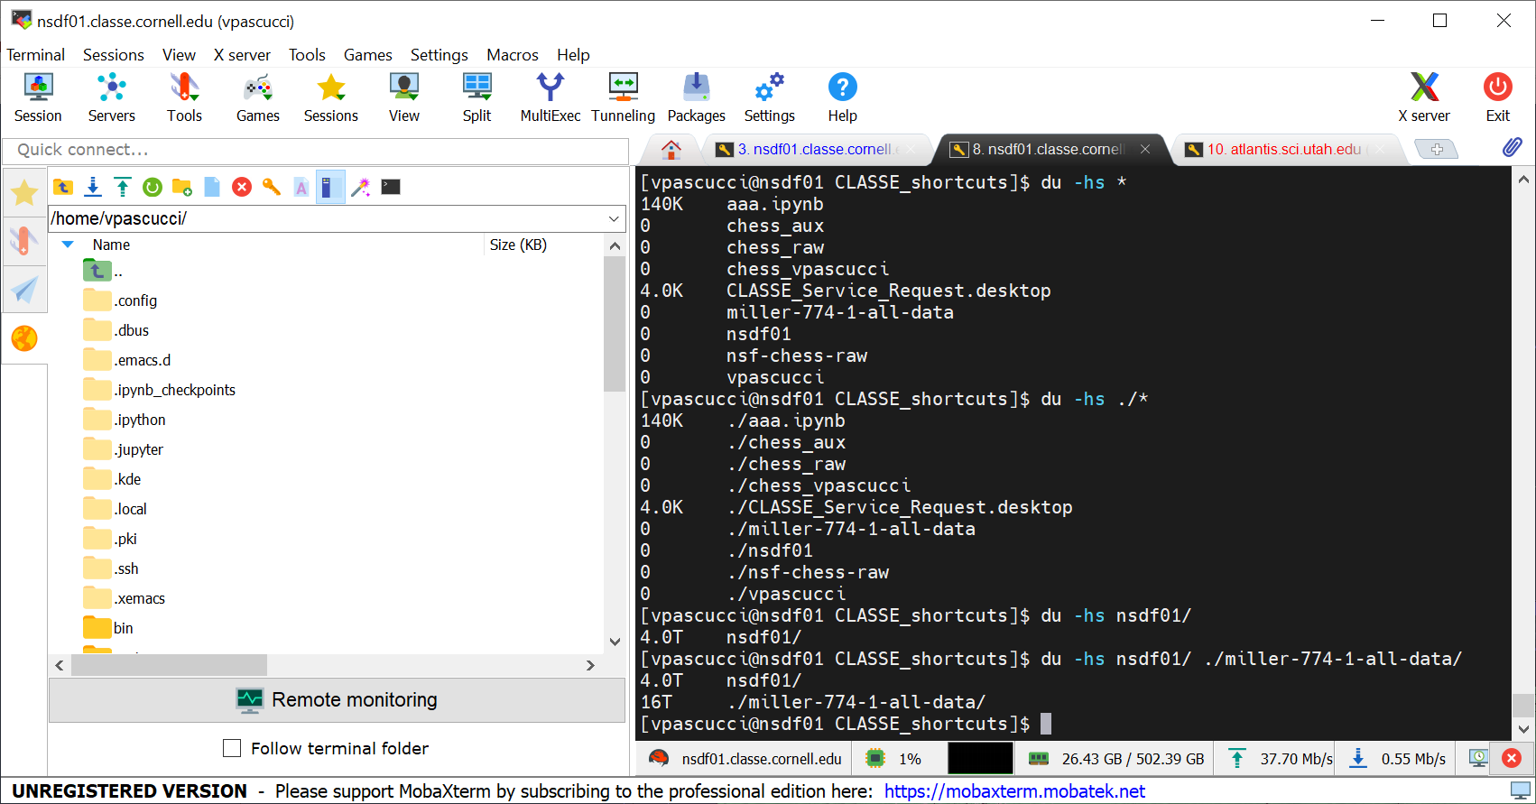
Direct Data Access & Steering from Cornell High Energy Synchrotron Source (CHESS)

Slide 32
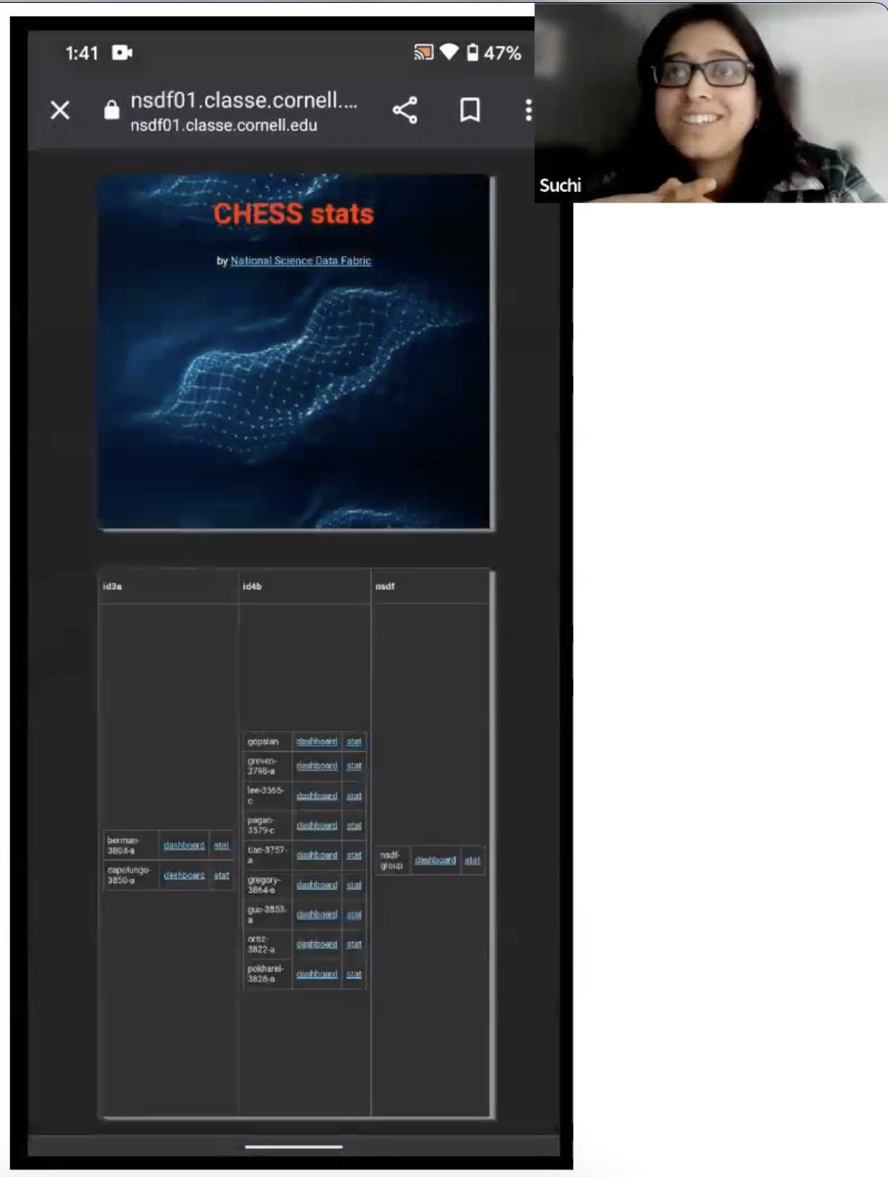

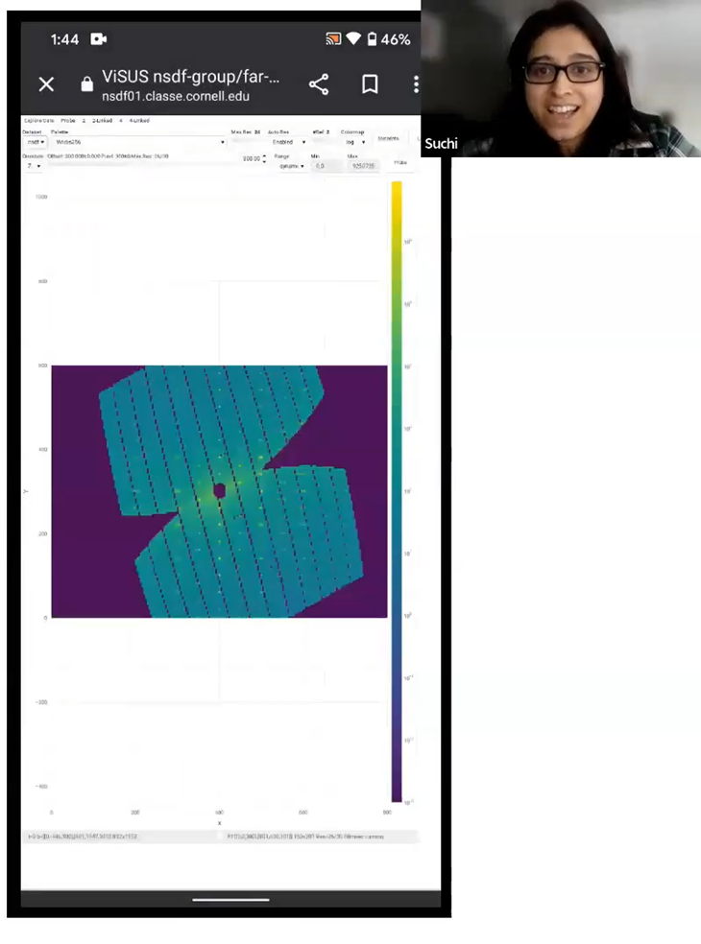
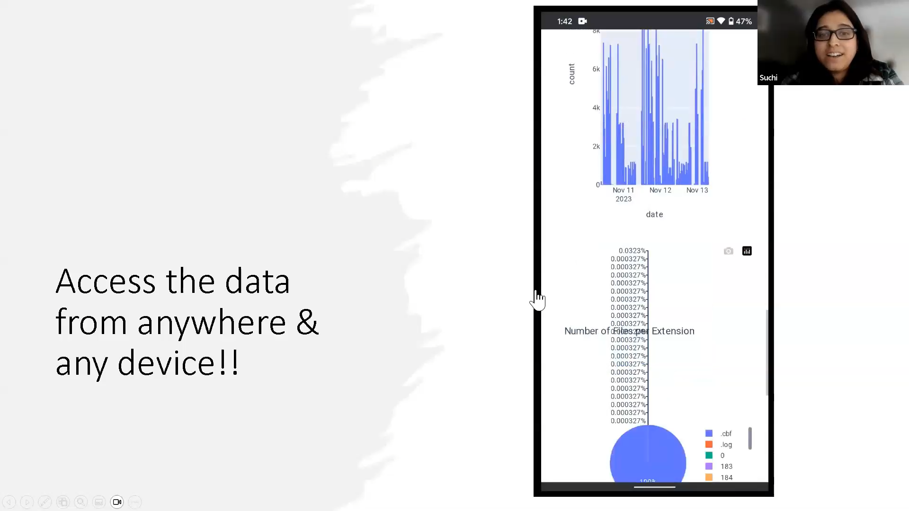
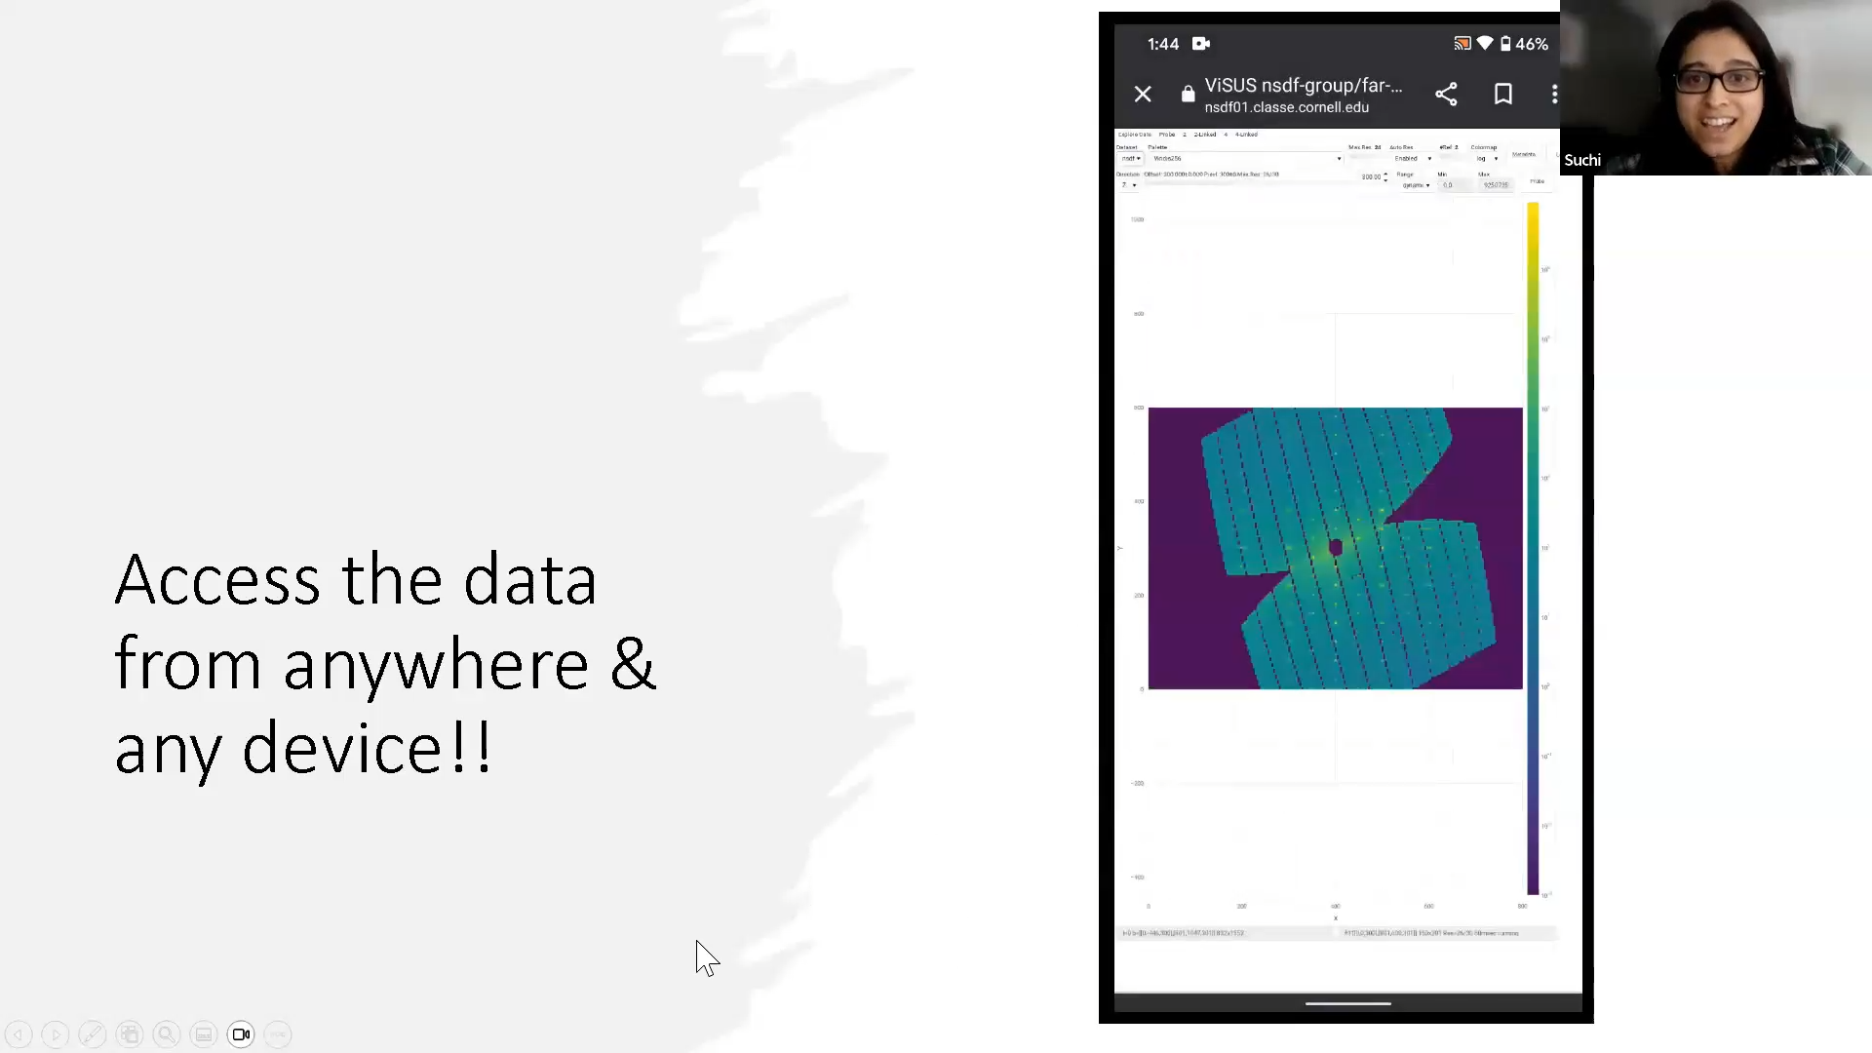

“You can access data from anywhere on any devices.”
– Suchismita (Suchi) Sarkar
Staff Scientist, CHESS

Slide 33
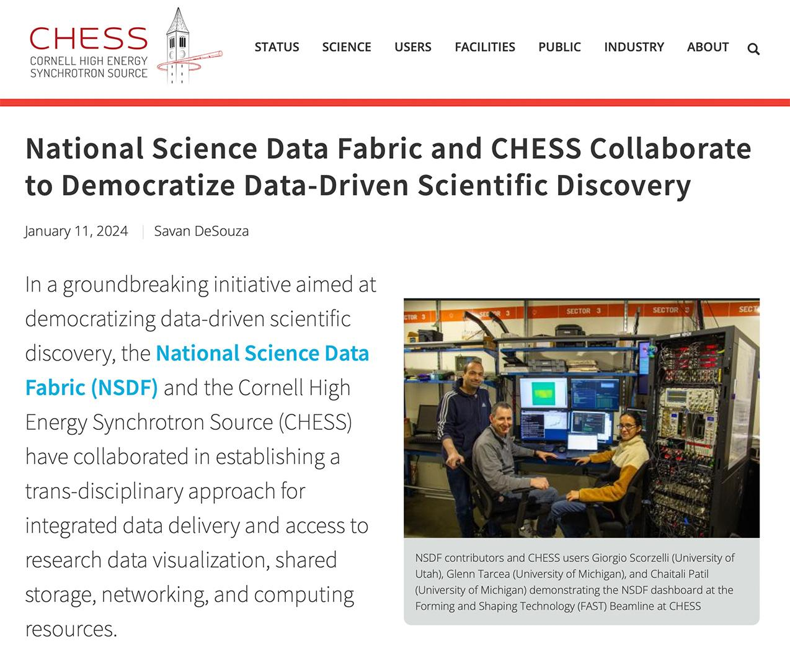

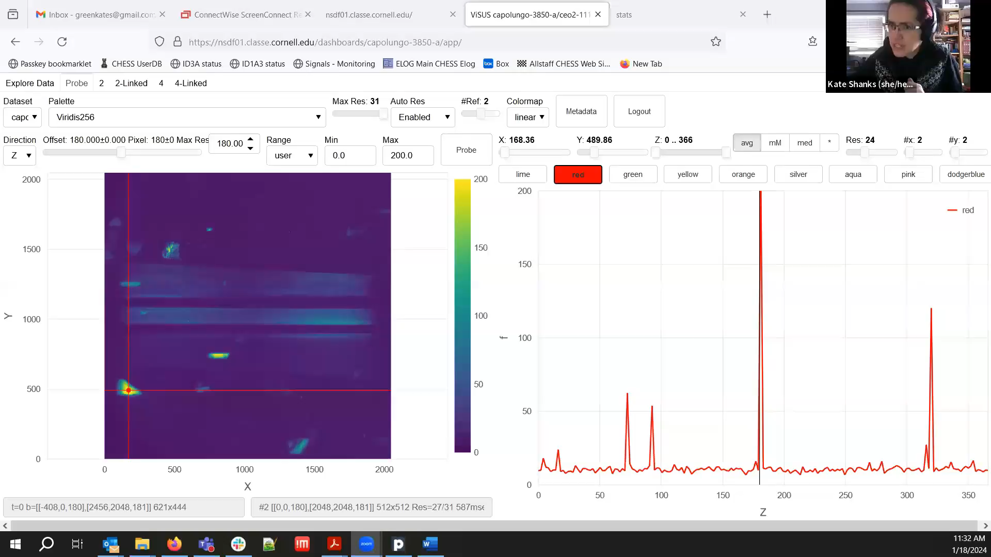
Kate Shanks, CHESS
“It's much easier to pop open one of these image stacks on here, in your web browser, as opposed to trying to open it up on ImageJ. If you do that on the station computer, sometimes you crash the computer. So this decouples that and lowers the barrier to examining the datasets on the fly..”
-Kate Shanks, FAST beamline scientist
https://www.chess.cornell.edu/national-science-data-fabric-and-chess-collaborate-democratize-data-driven-scientific-discovery
12

Slide 34

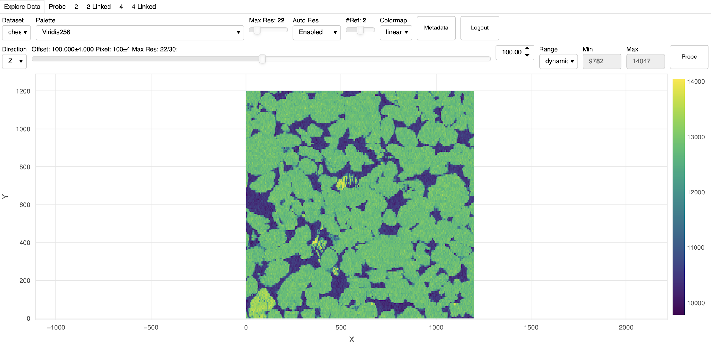
Check Out the CHESS NSDF-Dashboard

Slide 35

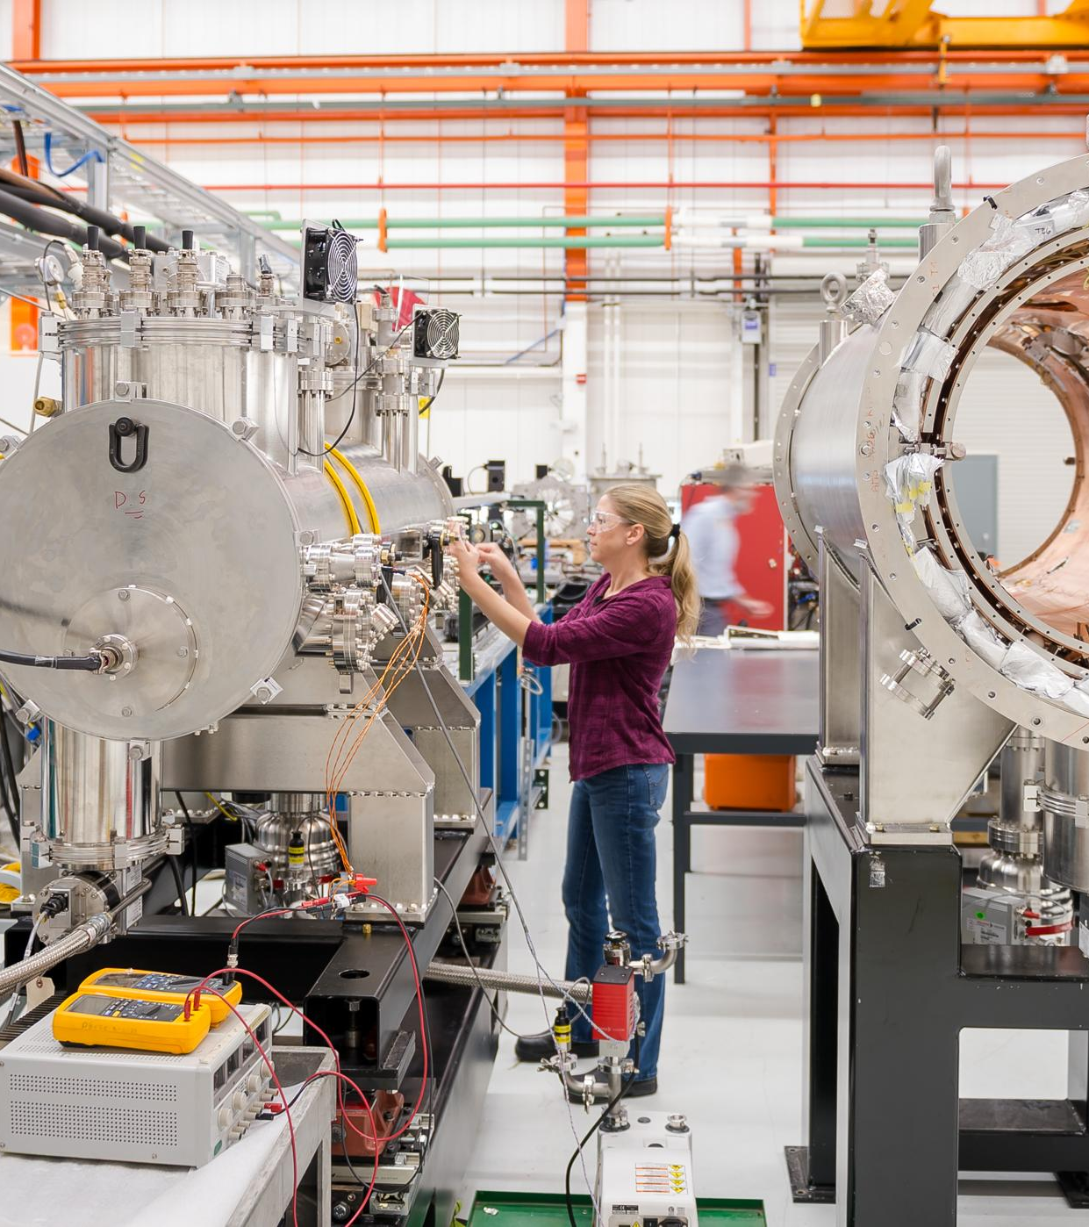
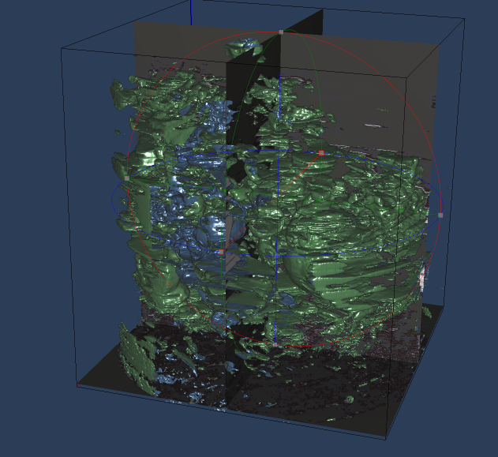
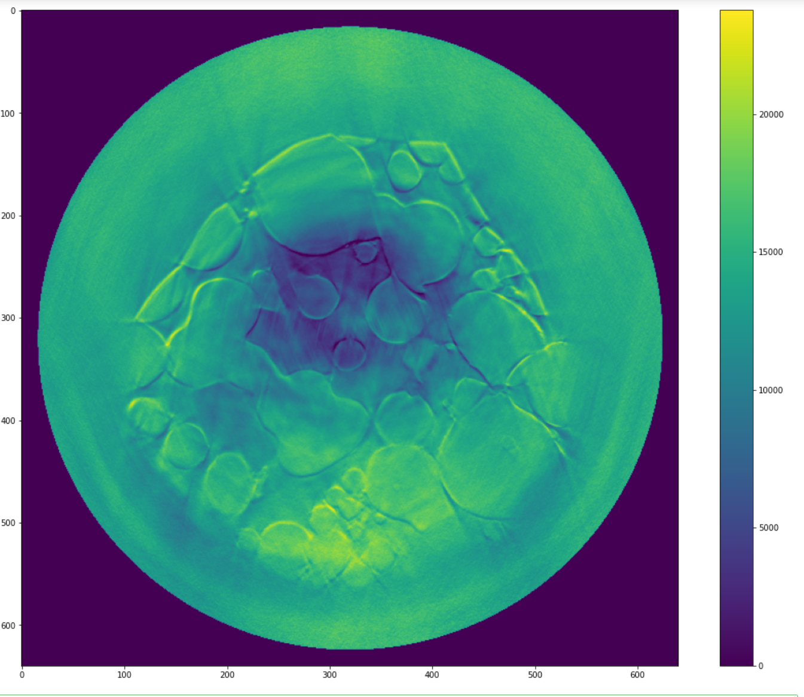
Equity in Research with National Labs
Facilitating rapid processing of 100+ terabytes of data by compact virtual laboratories, achieving in days what would take months for moving data between national labs and universities.
A porous
silica material
3D rendering
single slice of the material
Pania Newell
Professor in Mechanical Engineering at UoU
Analysis of the internal structure of porous silica materials at different stress levels
Over 400TB of generate data and more than 200 machines used on CloudLab, Chameleon, & AWS
http://services.nationalsciencedatafabric.org/materialscience

Slide 36

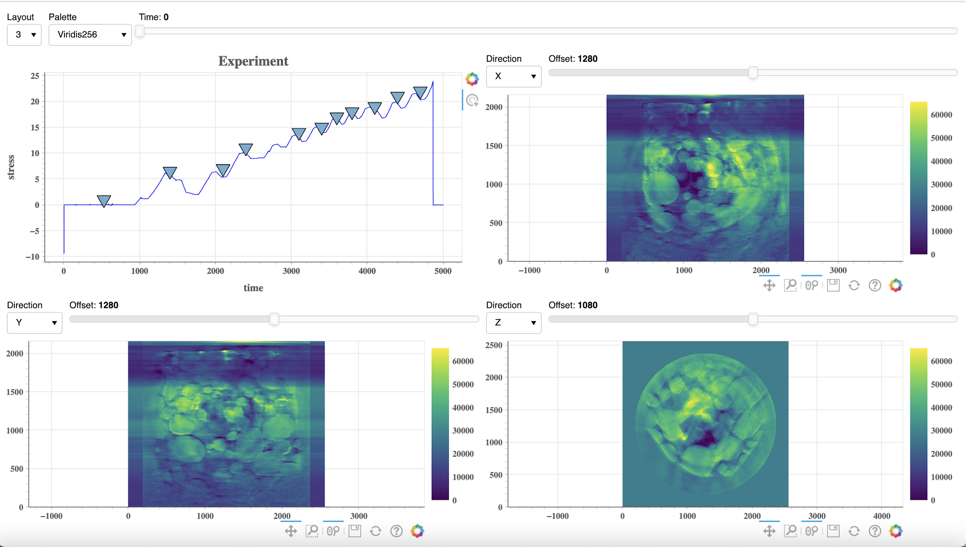
Check Out the Material Science NSDF-Dashboard

Slide 37
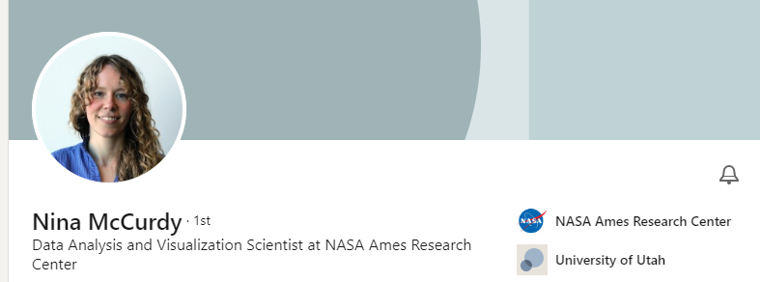
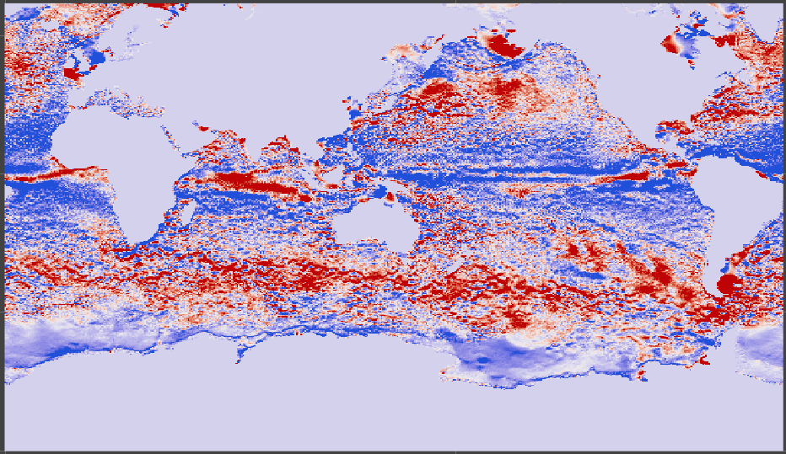

Equity in Accessing Full Data in Real-Time from HCP and Cloud
Enabling streaming data access and processing in a distributed cyberinfrastructure for NASA climate modeling data (from Pleiades Supercomputer & Cloud)
LLC4320 2.8 PB Ocean dataset
Model of ocean circulation and global ocean data to study the circulation role in climate changes
Requirements:
Access the full data
Overcome limitations in computational power
Provide real-time processing capabilities.

Slide 38
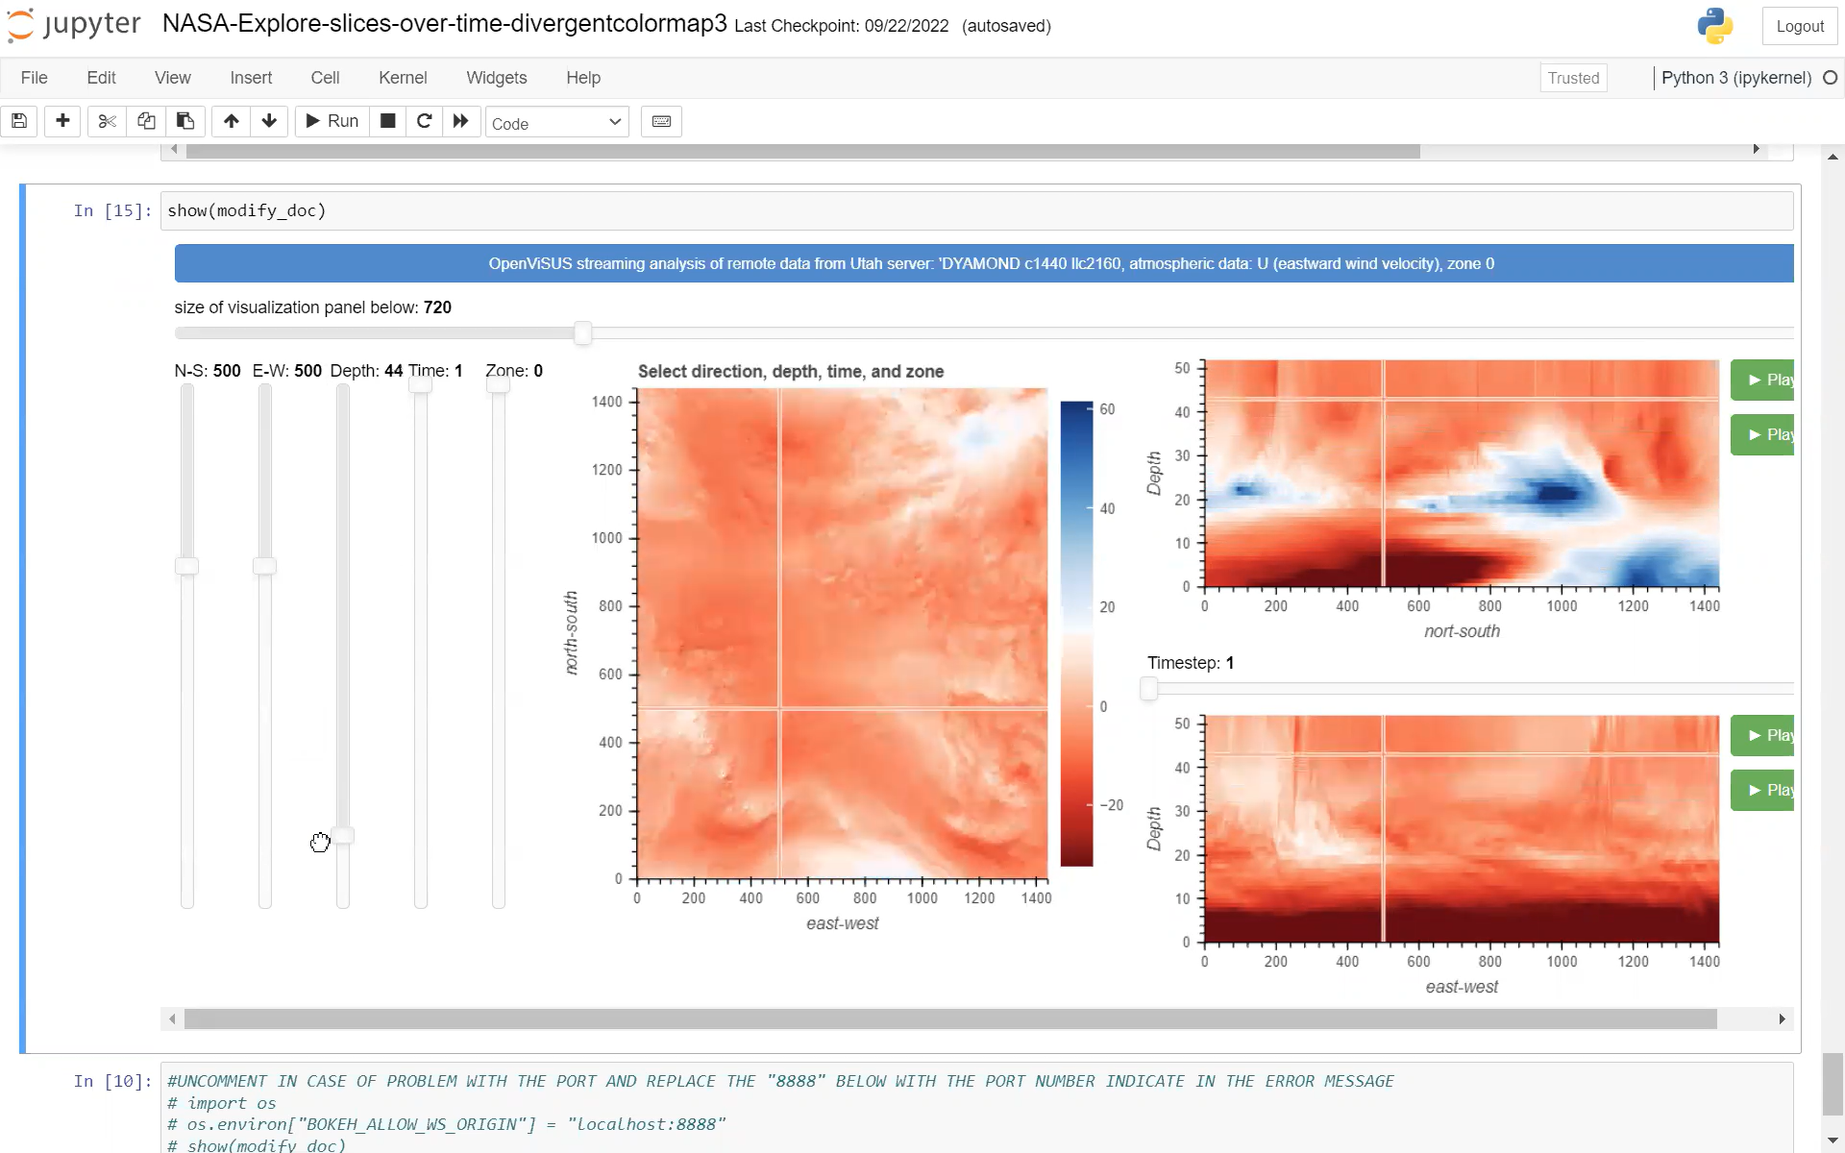
Streaming Data Access for Run-Time Analysis

Slide 39

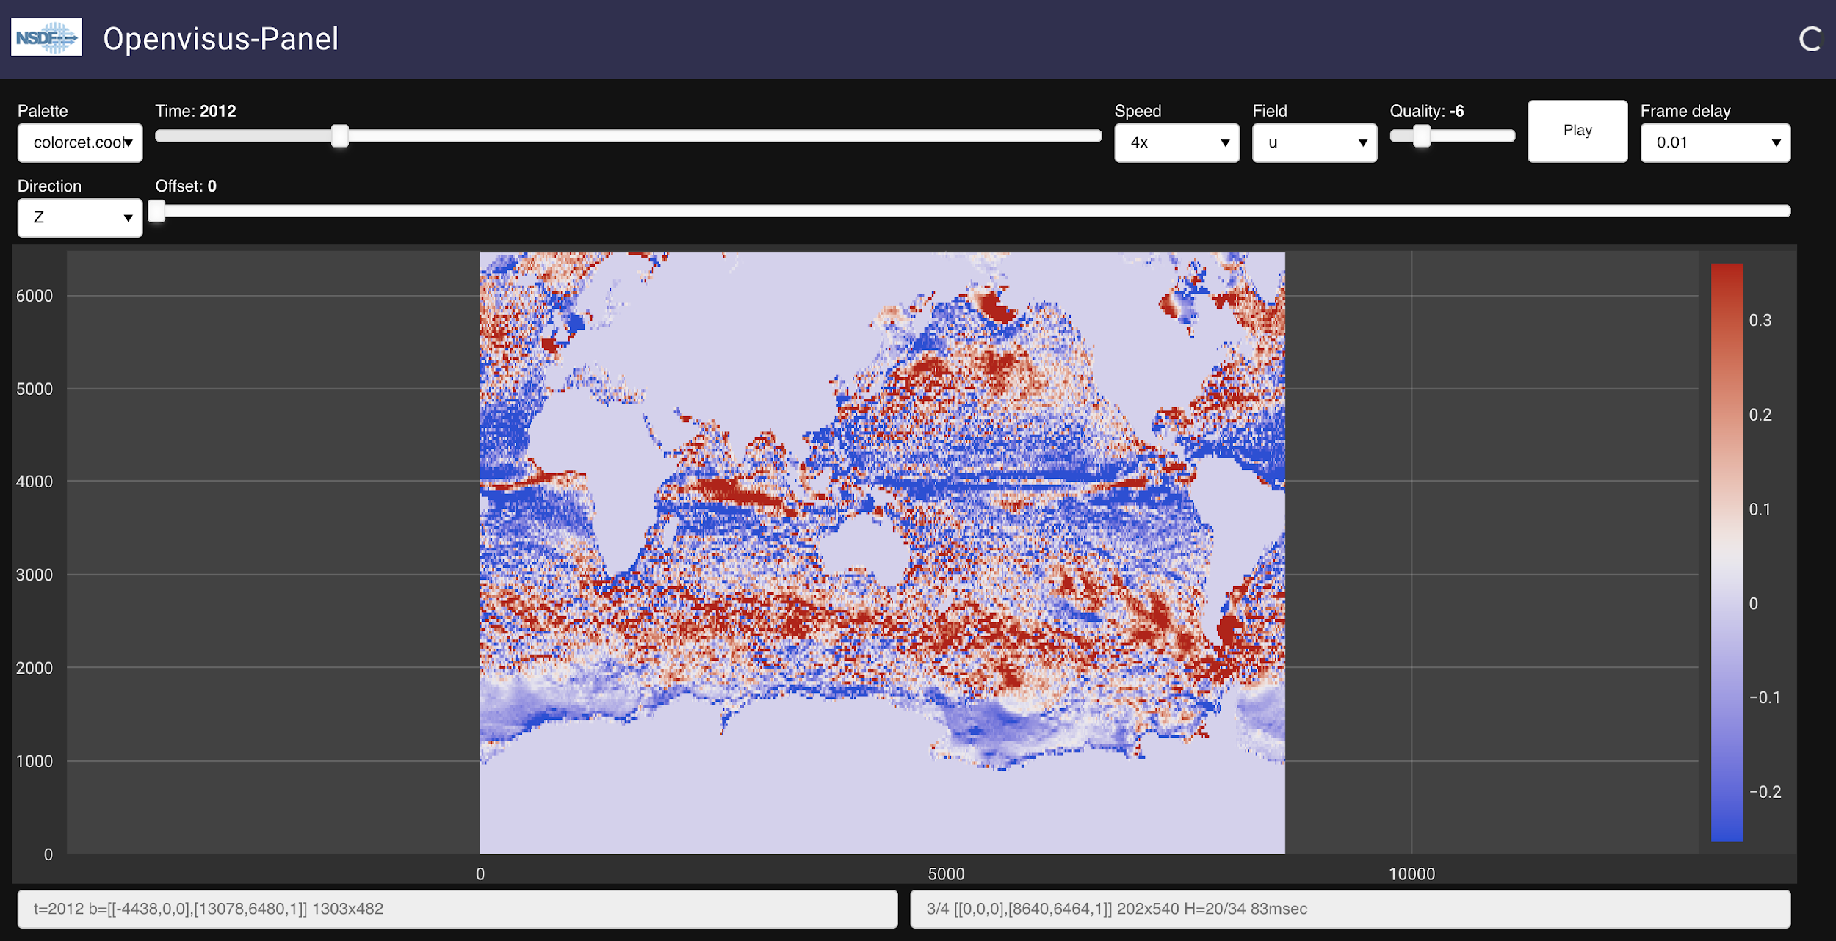
Check Out NASA Ocean NSDF-Dashboard

Slide 40
Session II: Training on using NSDF Services for End-to-End Analysis of Scientific Data
Democratizing Access and Use of Large-scale Data

Slide 41
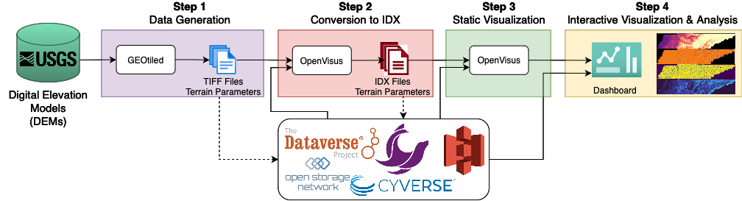
Four-Step Workflow Tutorial
This tutorial showcases the capabilities of NSDF, guiding you through a four-step modular workflow that leverages OpenVisus services to analyze a geospatial dataset generated with GEOtiled.
Step 1: Data Generation
Collect DEMs from the United States Geological Survey (USGS). Process them with GEOtiled or upload the data from public or private storage.
Step 2: Conversion to IDX Format
Convert files from TIFF to IDX (the format used by OpenVisus), preserving accuracy but reducing size. Store IDX files in public or private storage.
Step 3: Static Visualization
Statically visualize the terrain parameters in OpenVisus. Validate accuracy of IDX-based images with the TIFF-based images.
Step 4: Interactive Visualization
& Analysis
Launch dashboard for interacting with large-scale data to access subregions of the
original dataset for ad hoc analysis

Slide 42
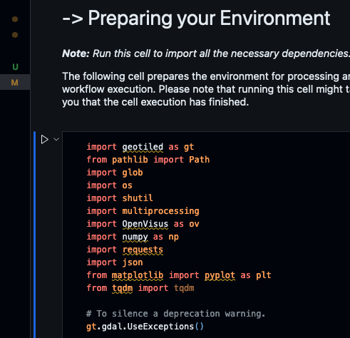
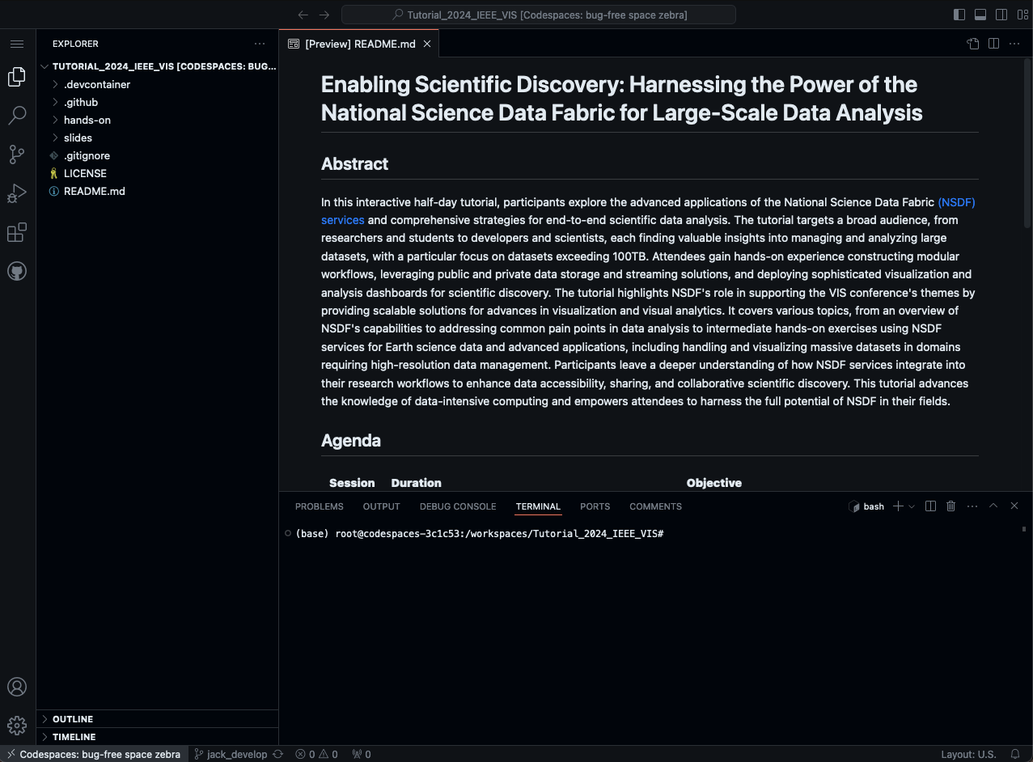
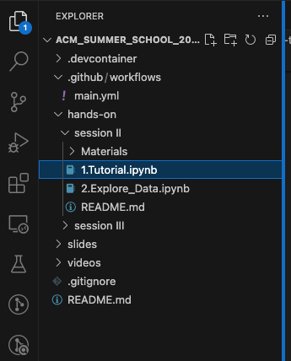
(1) Your codespace is fully loaded. Now you should see this screen
(3) Look for the Preparing your Environment section and press the play button
Tutorial
(2) Select the file 1.Tutorial.ipynb using the side bar
Instructions continue

Slide 43
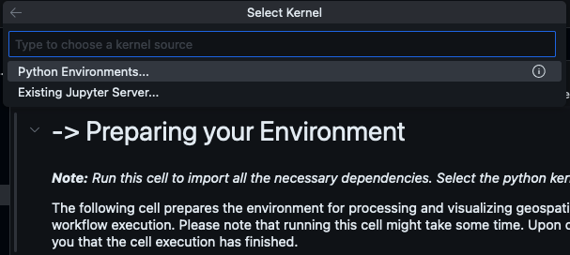
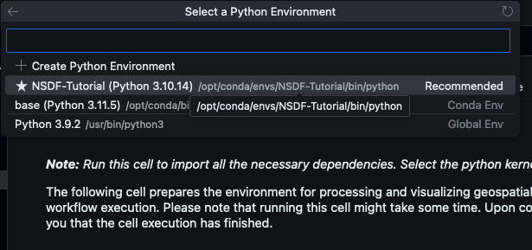
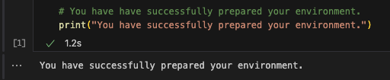
(4) A list to Select Kernel should pop up. Select Python Environments…
Tutorial
(6) After running the Preparing your Environment cell, you should see a message saying it was successfully prepared
(5) Select the ★NSDF-Tutorial option

Slide 44
Step 1: Data Generation with GEOtiled
Step 1: Data Generation
Collect DEMs from the United States Geological Survey (USGS) and process them with GEOtiled or upload the data from public or private storage.
Step 1 provides two options to obtain data and generate the TIFF files before proceeding with Step 2
Option A
Generating Data Using the SOMOSPIE Application Module
Option B
Accessing data from Dataverse public commons

Slide 45
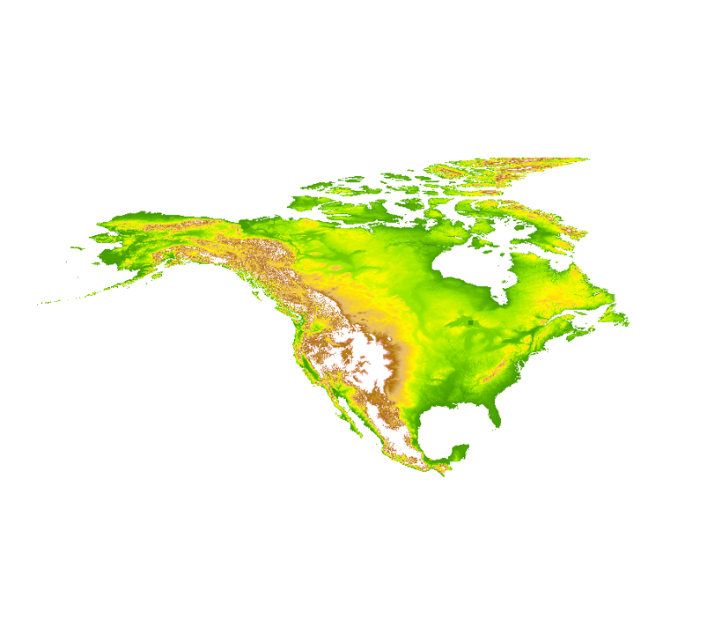
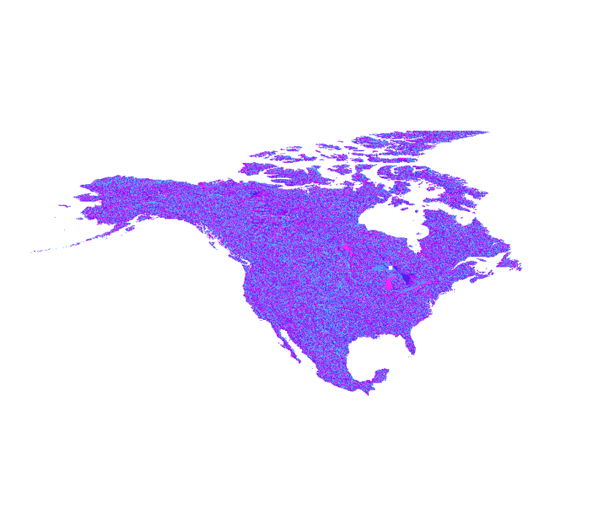







Step 1: What are Terrain Parameters?
Elevation
Aspect
Slope
Terrain parameters (e.g., slope, aspect, hillshading, etc.) are descriptions of surface form derived from Digital Elevation Models (DEM).
They play a fundamental role in applications such as precision forestry and agriculture, and hydrology for landscape ecology.
Hillshading
Channel Network Base Level
LS Factor
Generating terrain parameters at high-resolution is computationally expensive, hindering their accessibility by the scientific community
Topographic Wetness Index
Valley Depth
Closed Depressions

Slide 46














Step 1: Components
SOMOSPIE (SOil MOisture SPatial Inference Engine) has four components that empower scientists to generate, predict, and analyze high-resolution topographic data
Terrain Parameters
Training Data
Test Data
Elevation
Aspect
~ 26,000 training points
X | Y | Soil Moisture | Covariate 1 | Covariate 2 | Covariate 3 | Covariate… 4
X 1 | Y 1 | SM 1 | A 1 | B 1 | C 1 | N 1
X 2 | Y 2 | SM 2 | A 2 | B 2 | C 2 | N 2
X 3 | Y 3 | SM 3 | A 3 | B 3 | C 3 | N 3
X 4 | Y 4 | SM 4 | A 4 | B 4 | C 4 | N 4
X 5 | Y 5 | SM 5 | A 5 | B 5 | C 5 | N 5
X… N | Y… N | SM… N | A… N | B… N | C… N | N… N
X | Y | Covariate 1 | Covariate 2 | Covariate 3 | Covariate… 4
X 1 | Y 1 | A 1 | B 1 | C 1 | N 1
X 2 | Y 2 | A 2 | B 2 | C 2 | N 2
X 3 | Y 3 | A 3 | B 3 | C 3 | N 3
X 4 | Y 4 | A 4 | B 4 | C 4 | N 4
X 5 | Y 5 | A 5 | B 5 | C 5 | N 5
X… N | Y… N | A… N | B… N | C… N | N… N
Hillshading
Sample points every ~27 km
Sample points every X meters
Slope

Slide 47





Step1: Terrain Generation
We expand on the first component, GEOtiled, that computes high-resolution terrain parameters using Digital Elevation Models (DEMs)
GEOtiled leverages data partitioning to accelerate the computation of terrain parameters from DEMs while preserving accuracy
Digital Elevation Model (DEM)
Computing High-resolution Terrain Parameters
Terrain Parameters
Terrain Parameter 1: Aspect
Elevation
Aspect
Slope
Hillshading

Slide 48

Step1: Terrain Generation
GEOtiled generates high-resolution terrain parameters at a large scale from a DEM. It has three stages: (1) we crop DEM into tiles, with buffer regions; (2) we compute the terrain parameters for each tile; (3) we build a mosaic from the tiles.

Slide 49
Step 1: Data Generation with GEOtiled
Tutorial
Step 1: Data Generation
Collect DEMs from the United States Geological Survey (USGS) and process them with GEOtiled or upload the data from public or private storage.
Step 1 provides two options to obtain data and generate the TIFF files before proceeding with Step 2
Option A (~10 mins)
Generating Data Using the SOMOSPIE Application Module
Option B (~3 mins)
Accessing data from Dataverse public commons

Slide 50

Step 1: Data Generation with GEOtiled
Tutorial

Slide 51

Step 2: Conversion to IDX
Tutorial
Converting to IDX from TIFF format reduces file size by 20% while preserving accuracy
OpenVisus is a progressive cache-oblivious framework for large-scale data visualization
Step 2: Conversion to IDX Format
Convert files from TIFF to IDX (the format used by OpenVisus), preserving accuracy but reducing size. Store IDX files in public or private storage.
The IDX data format stores the data in a hierarchical Z (HZ) order, providing efficient, progressive access to large-scale scientific datasets

Slide 52

Step 2: IDX Data Format
Why IDX?
The IDX data format provides efficient, cache-oblivious, and progressive access to large-scale scientific datasets.
Data stored in IDX format can be visualized in an interactive environment allowing for meaningful explorations with minimal resources.
IDX provides scalability across a wide range of running conditions like personal computers to distributed systems.
Conversion to IDX is not limited to TIFF; it will work on other data formats like NetCDF, HDF5, RGB, raw/binary, and so on.
IDX supports industry-standard lossless and lossy compression algorithms such as zlib, zfp, lz4.
Fine Resolution

Slide 53
Step 3: Static Visualization
Tutorial
Step 3 provides two options to obtain data and collect the IDX files
Step 3: Static Visualization
Statically visualize the terrain parameters in OpenVisus. Validate the accuracy of IDX-based images with TIFF-based images.
Option A
From local storage
Option B
From Seal Storage

Slide 54


Step 3: Static Visualization
Tutorial
Option A
From local storage

Slide 55


Step 3: Static Visualization
Tutorial
Option A
From local storage
Option B
From Seal Storage

Slide 56
Step 4: Interactive Visualization & Analysis
Tutorial
Remotely access large datasets, zoom into specific areas, select and crop subregions of interest, save data locally in a Python-compatible format, and analyze the data for scientific discovery.
Step 4: Interactive Visualization
& Analysis
Launch dashboard for interacting with large-scale data to access subregions of the
original dataset for ad hoc analysis.
Step 4 provides two options to obtain data and collect the IDX files
Option A
From local storage
Option B
From Seal Storage

Slide 57


Step 4: Geographical Regions
Visualize and analyze two geographical regions at 30 m resolution
State of Tennessee - 200 MB
Contiguous United States (CONUS) - 200 GB

Slide 58
Step 4: Interactive Visualization & Analysis
Tutorial
Remotely access large datasets, zoom into specific areas, select and crop subregions of interest, save data locally in a Python-compatible format, and analyze the data for scientific discovery.
Step 4: Interactive Visualization
& Analysis
Launch dashboard for interacting with large-scale data to access subregions of the
original dataset for ad hoc analysis.
Step 4 provides two options to obtain data and collect the IDX files
Option A
From local storage
Option B
From Seal Storage

Slide 59

## Stop this cell before running another visualization dashboard

Slide 60

Step 4: Interactive Visualization & Analysis
Tutorial
Remotely access large datasets, zoom into specific areas, select and crop subregions of interest, save data locally in a Python-compatible format, and analyze the data for scientific discovery.
Step 4: Interactive Visualization
& Analysis
Launch dashboard for interacting with large-scale data to access subregions of the
original dataset for ad hoc analysis.
Step 4 provides two options to obtain data and collect the IDX files
Option A
From local storage
Option B
From Seal Storage

Slide 61

## Stop this cell before running another visualization dashboard

Slide 62
Step 4: Geographical Regions
Visualize and analyze two geographical regions at 30 m resolution
State of Tennessee - 200 MB
Contiguous United States (CONUS) - 200 GB

Slide 63



Step 4: Analysis of Large-Scale Subregions
Visualize large-scale data remotely
Select and explore subregions
Save the subregions of interest locally in file zoom-conus-r01
Pan
Box Selection
Wheel Zoom

Slide 64


Hands on Exercise: Exploring your Subregion Data
(1) Load the downloaded subregion of interest in your local machine
(2) Compute min, max, average and std elevation
(3) Set the color bar to reflect the range of displayed data, from the minimum to the maximum value, providing a more accurate visual representation of the data

Slide 65
Hands on Exercise: Exploring your Subregion Data
(1) Load the downloaded subregion of interest in your local machine
(2) Compute min, max, average and std elevation
(3) Set the color bar to reflect the range of displayed data, from the minimum to the maximum value, providing a more accurate visual representation of the data

Slide 66
Discussion and Open Questions
Construct a modular workflow that combines your application components with NSDF services
Can you think of an application that is modular? Can you leverage its APIs?
Can the application take advantage of the NSDF services?
Upload, download, and stream data to and from public and private storage solutions
How large is the application’s data? How do you access, share, and store the data?
Can the data take advantage of private and public storage?
Deploy the NSDF dashboard for large-scale data access, visualization, and analysis
What type of analysis do you perform on the data?
Can your research take advantage of an interactive dashboard?

Slide 67


Tutorial Links
NSDF
GEOtiled
SOMOSPIE
OpenVisus

